Slide 1
The Worst Way to Go
By Nick Jaillet

Slide 2
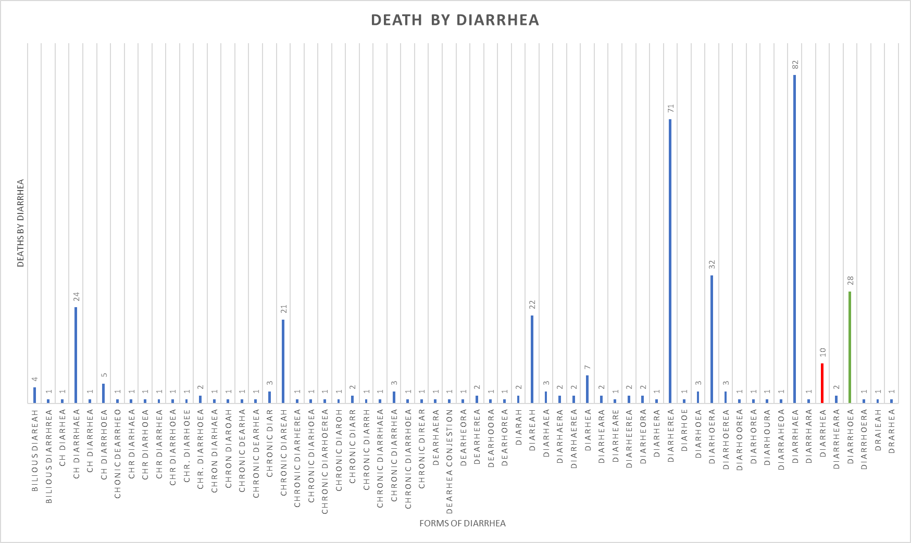
63 different spellings of Diarrhea.
Most common spelling Diarrhaea.
British spelling Diarrhoea.
376 cause of deaths labeled DIARRHEA!

Slide 3
Why Nashville Cemetery
You can find your favorite cause of death or your favorite form of Diarrhea.
The fun at the cemetery is up to you so make it your own.

Slide 4
Side Note
Former President J.K. Polk is buried in Nashville cemetery.

